Slide 1
Matlab implementation (1D space discretization) (3D dimensionality of particles)

Slide 2
Initial data structures
Given Np particles, Nx grid partitions and Ns species
m, q, beta: scalar properties of each particle (Np x 1)
x, v: vector properties of each particle (Np x 3)
vt: vector velocity of each particle at half time step (Np x 3)
E, B: electric and magnetic fields at grid points (Nx x 3)
Et, Bt: fields at grid points at half time step (Nx x 3)
Ep, Bp: electric and magnetic fields at particle positions (Np x 3)
Alpha: rotation vector for each particle (Np x 3 x 3)
J: hatted current (vector) for every given cell (Nx x 3)
M Mass matrices

Slide 3
Algorithm steps
Step 1: advance particle positions

Slide 4
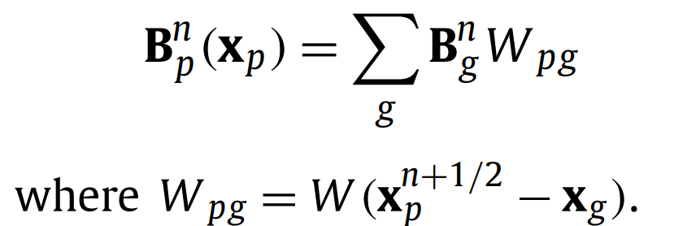
Algorithm steps
Step 2: interpolate magnetic field
If W is of degree 1 as suggested in paper it’s just linear interpolation of the grid to the particle positions.

Slide 5
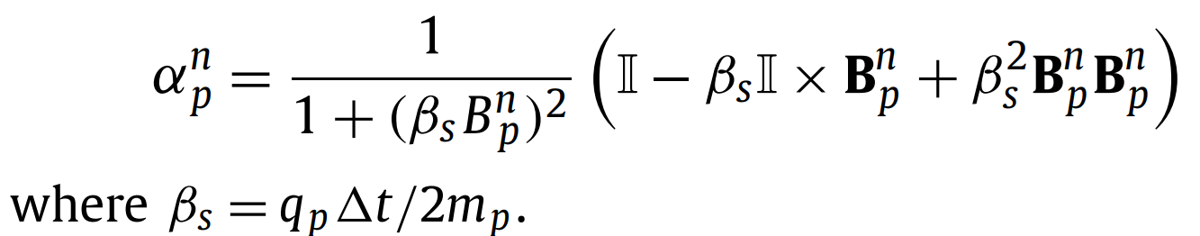
Algorithm steps
Step 3: calculate rotation matrices for each particle
Same thing?
How to square a vector?
Matrix cross vector?

Slide 6
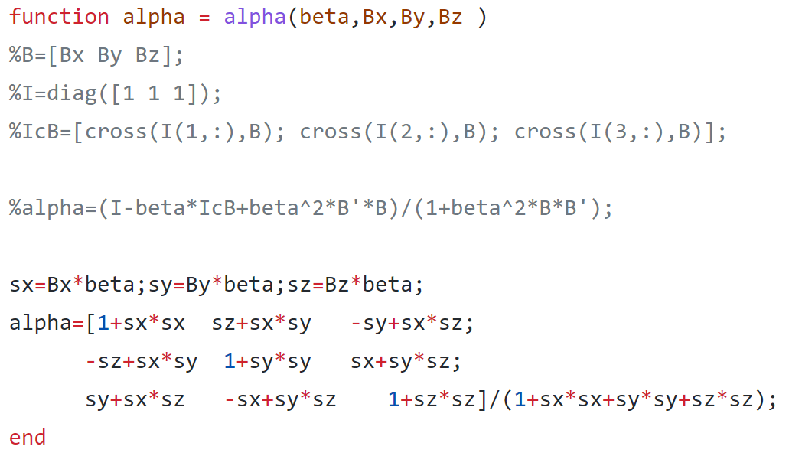
Algorithm steps
Found the author’s repo:

Slide 7


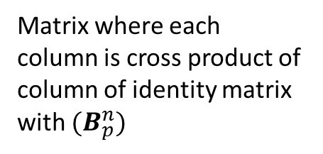
Algorithm steps
Step 3: calculate rotation matrices for each particle
Matrix where each column is cross product of column of identity matrix with ${(B}_{p}^{n})$
${(B}_{p}^{n})$ ${{(B}_{p}^{n})}^{t}$
${{(B}_{p}^{n})}^{t}$ ${(B}_{p}^{n})$

Slide 8
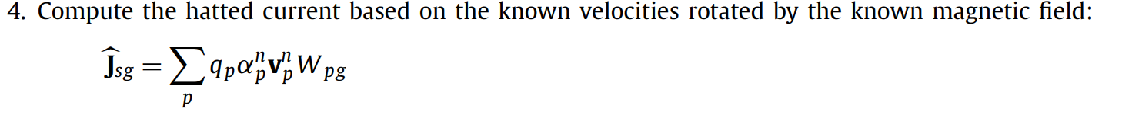
Algorithm steps
Naive implementation: for every grid point check if particle is inside and if it is calculate weighting. O(Np x Nx)
For actual code: iterate over particles and add to relevant cell. O(Np)

Slide 9
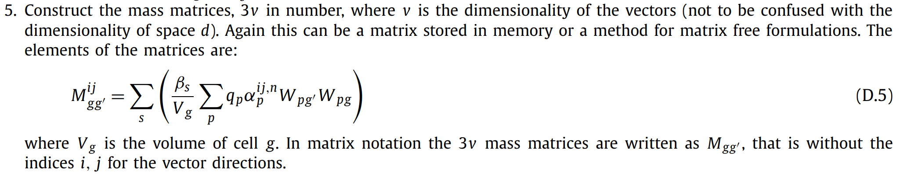
Algorithm steps
Naive implementation: for every pair of grid cells calculate Mgg’. O(Nx^2 x Np)
For actual code: iterate through particles and add where relevant. O(Np)
Assuming Vg = dx in 1D

Slide 10
Algorithm steps
Naive implementation: for every pair of grid cells calculate Mgg’. O(Nx^2 x Np)
Iterate through particles and add where relevant. O(Np)
Way too slow
Need this
For further code: Mgg’ = Mg’g so avoid calculating both
For further code: Vg and betas multiply everything so avoid multiplying inside

Slide 11
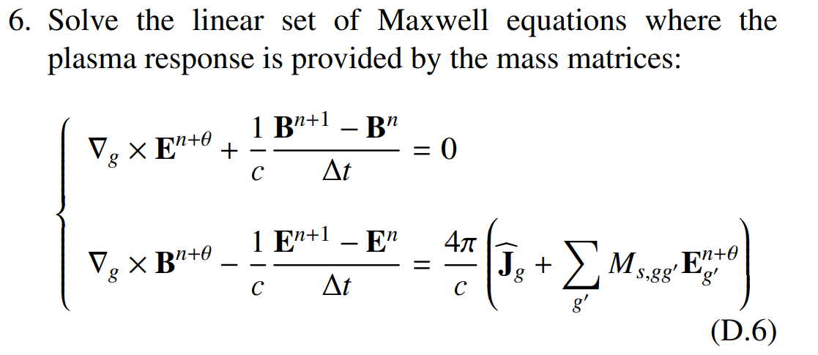
Algorithm steps
6 equations per grid cell
But 12 unknows
Assume that changes in fields are linear in a single time step
Six unknows

Slide 12
Grid discretization
The paper suggests that the electric field should be located at the edge of each partition while the magnetic field should be located at the centre of each cell.
However: with first order interpolation as suggested in the paper, I don’t see how it can make a difference. ➔ I’m going to try it with both fields at the edge of the cells which is much easier and then check if results are accurate and energy is conserved.

Slide 13
Algorithm steps
We end up with a 6Nx dimensional system of linear equations.

Slide 14
Algorithms steps
Only part of the matrix that changes in every iteration.

Slide 15
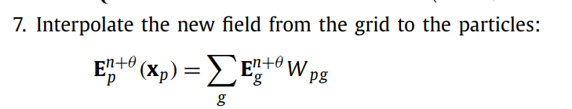
Algorithms steps

Slide 16
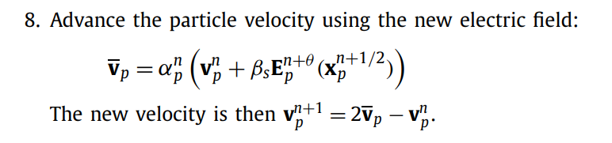
Algorithms steps

Slide 17
Additional steps
When particles go beyond Lx return them to 0.

Slide 18
Observation
I’ve been doing 1D3V simulations while in last year it was all 1D1V

Slide 19
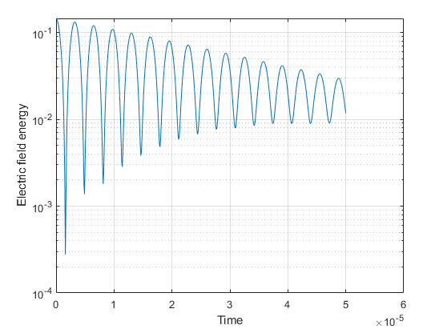
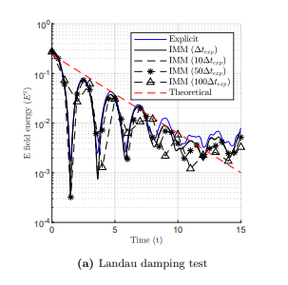
Landau Damping
Wave perturbation in electric field
t_max = 0.00005 dt = 0.0000001

Slide 20
Landau Damping
Damping effect shows up, however the time scale is very different.
Perhaps it’s because I create wave perturbation in electric field directly instead of in the particles.

Slide 21

Initialization
Ref https://cds.cern.ch/record/2057438/files/1418884_181-206.pdf
And last year
Velocity distribution looks fine but not sure about mass.

Slide 22
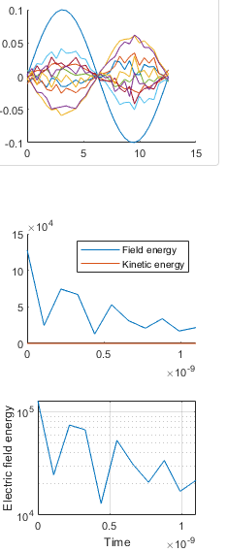
Small time steps

Slide 23
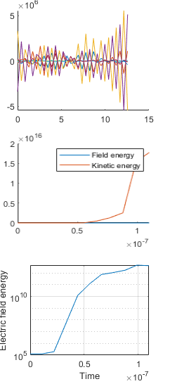
Larger mass
Instability if mass of particles is too high or time step is too small. This shouldn’t happen as the method should be unconditionally stable.

Slide 24
Overall
Looks good but scales are wrong: either initialization is wrong or some bug in the code like a wrong scaling.

Slide 25
Also
For actual code, must solve finite grid instability:
i.e. not allow movement of more than one grid cell per time step.

Slide 26

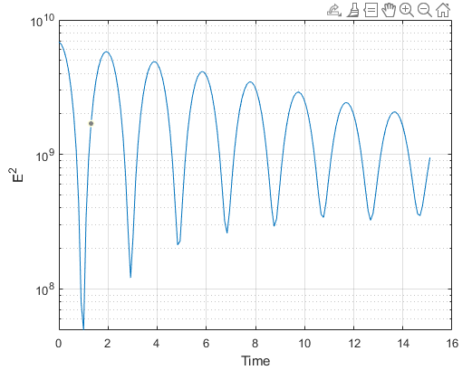
I finally understand
Previous code uses: m=1 and q=-1 for electrons, m=2000 and q=1 for ions. With these inputs (and same Np, Nx, dt…):
Using:
Mine:
Previous:
Same time scale ☺
But different energy scale

Slide 27
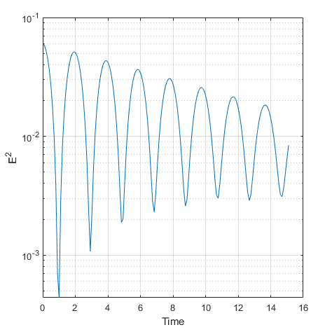
Normalizing
If in previous code $ε_{0}$ was assumed to be 0:
Mine:
Previous:
Very similar results, but slope is different

Slide 28
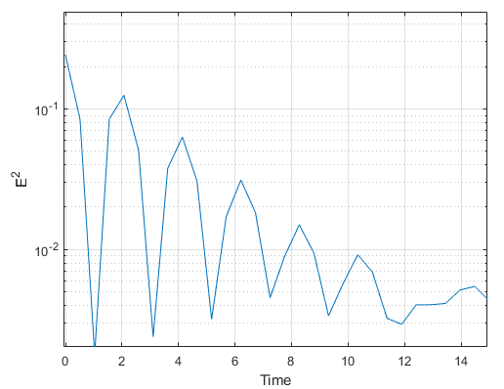
Further normalising
If c is 1 (which doesn’t appear in last year’s code):
Mine:
Previous:
Same slope, looks good

Slide 29
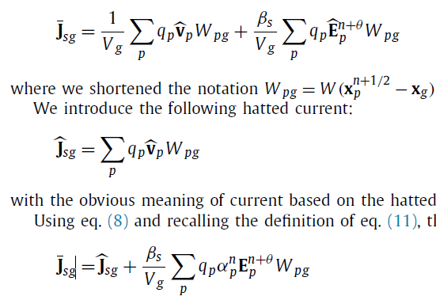

Error in the paper’s algorithm
With:
This means that energy is not conserved in the system unless dx = 1 as shown in the next slide
1/V term missing

Slide 30
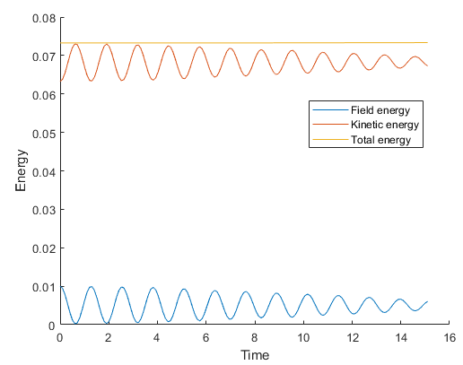
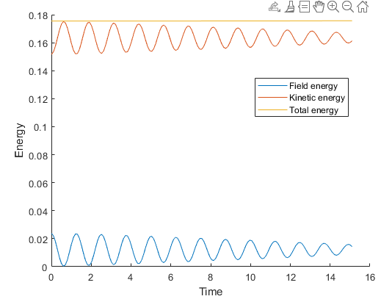
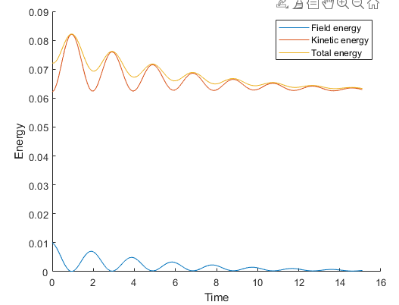
Comparison of Landau damping adding 1/Vg term
Adding 1/Vg term
Without 1/Vg term
Any dx
dx not 1
dx = 1

Slide 31
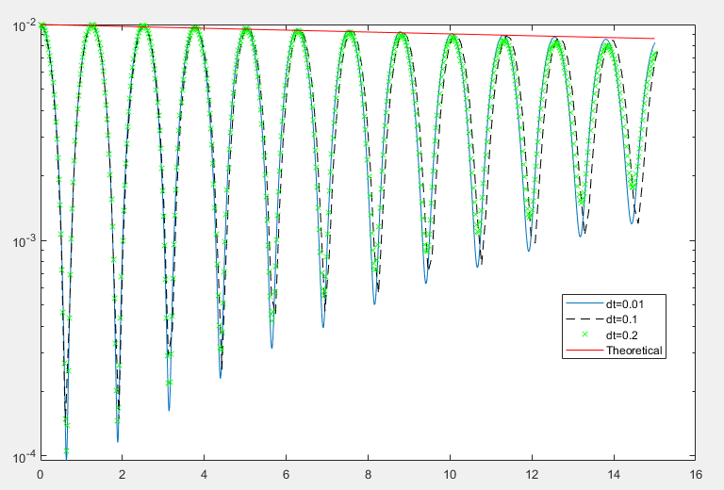
Comparison of changing time step in Landau damping
Linear damping as expected from theory

